Slide 1





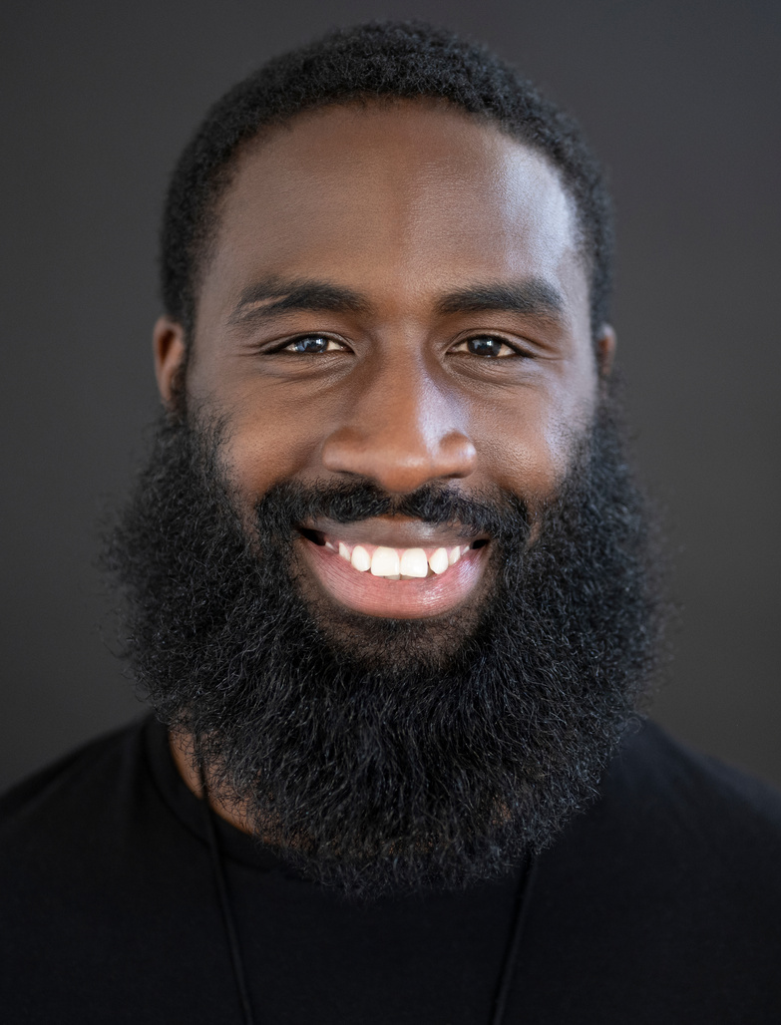
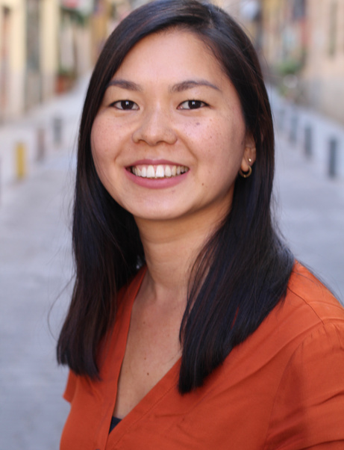



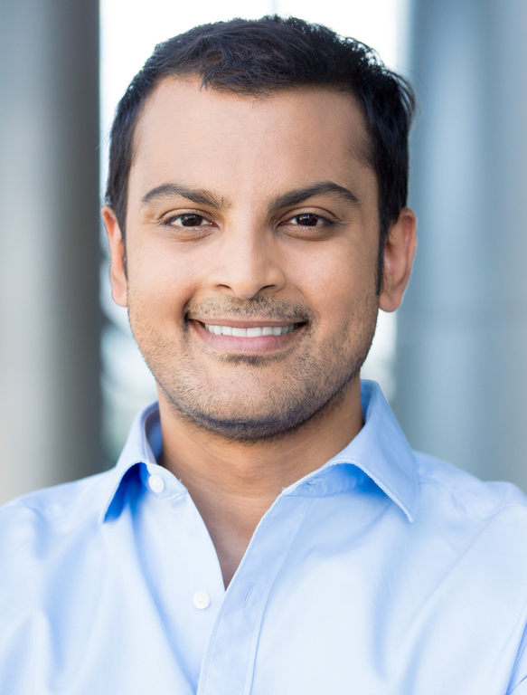

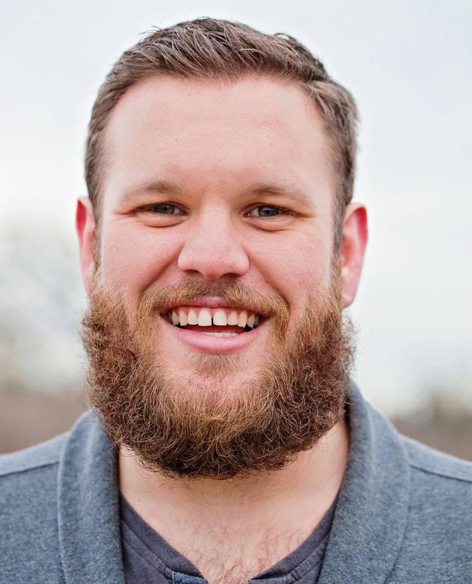
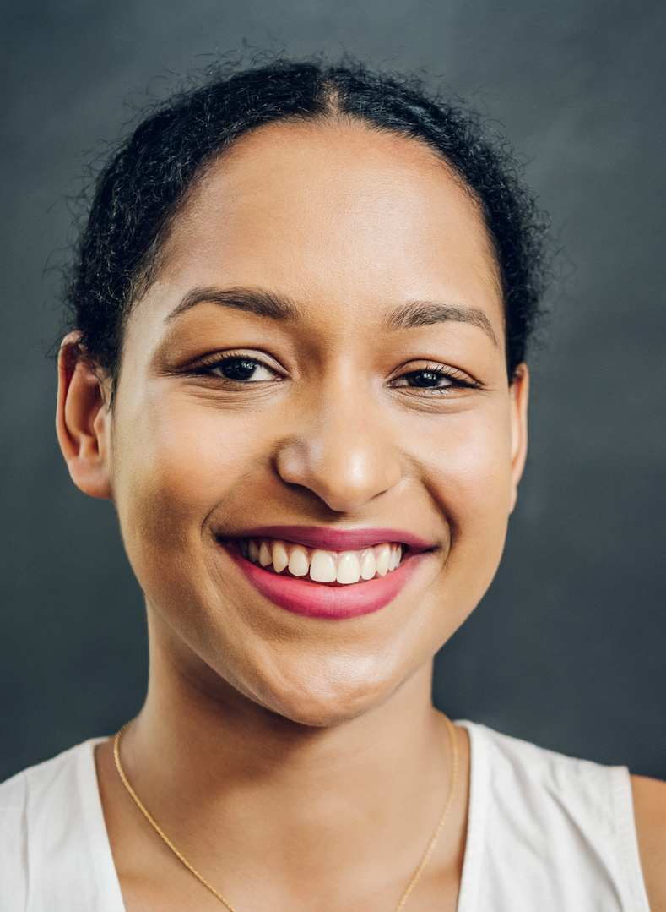

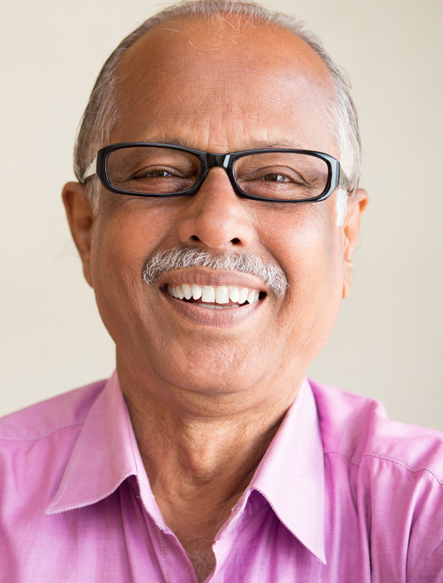
AI FOR ALL
EMPOWERING DIVERSE
COMMUNITIES
Tuesday, August 27th from 12-1 pm ET

Slide 2

AI for All: Empowering Diverse Communities
Bunifu and SaNDAI Cares have partnered to bring cutting-edge AI solutions to underserved populations. This webinar explores our collaborative efforts to provide specialized Data Analytics and Generative AI training programs for high school students, pre-release and post-incarcerated citizens, and veterans. Join us to learn how we're bridging the AI divide and creating opportunities for diverse communities to thrive in the digital age.

Slide 3

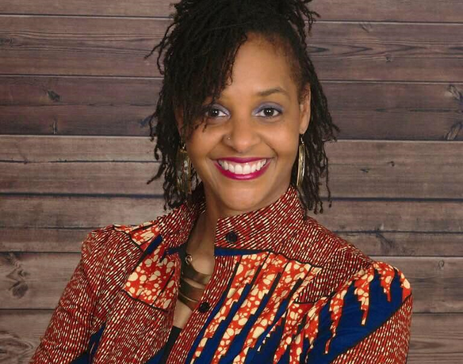
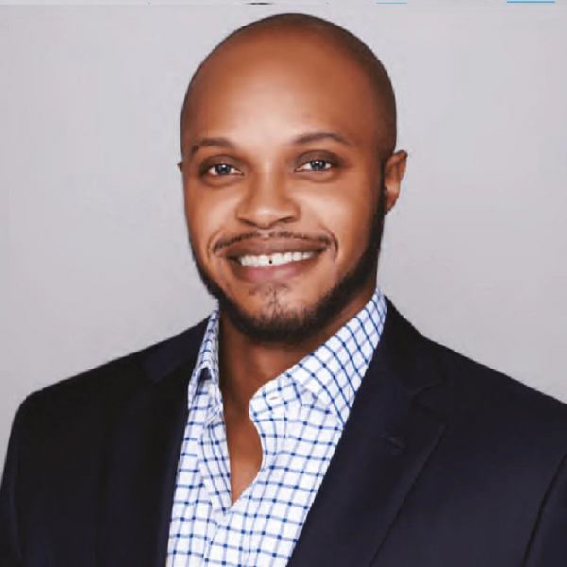
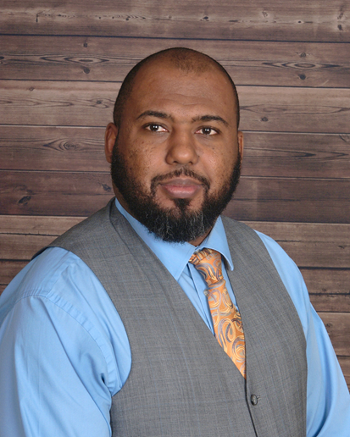
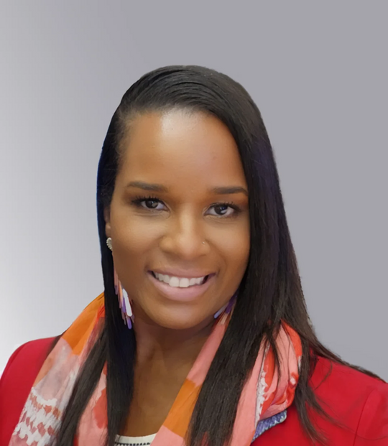
JENNIFER DUNN
FOUNDER & CO-OWNER
BUNIFU - LEARNING FOR LIFE
JEREMY WILLIAMS
CHIEF EXECUTIVE OFFICER (CEO)
SANDAI GLOBAL
CLAUDETTE KEEN
DIRECTOR OF TRAINING PROGRAMS
SANDAI GLOBAL
MAURICE DUNN
FOUNDER & CO-OWNER
BUNIFU - LEARNING FOR LIFE

Slide 4

“Poll Questions”
The AI Pulse Check: Where Do We Stand?

Slide 5
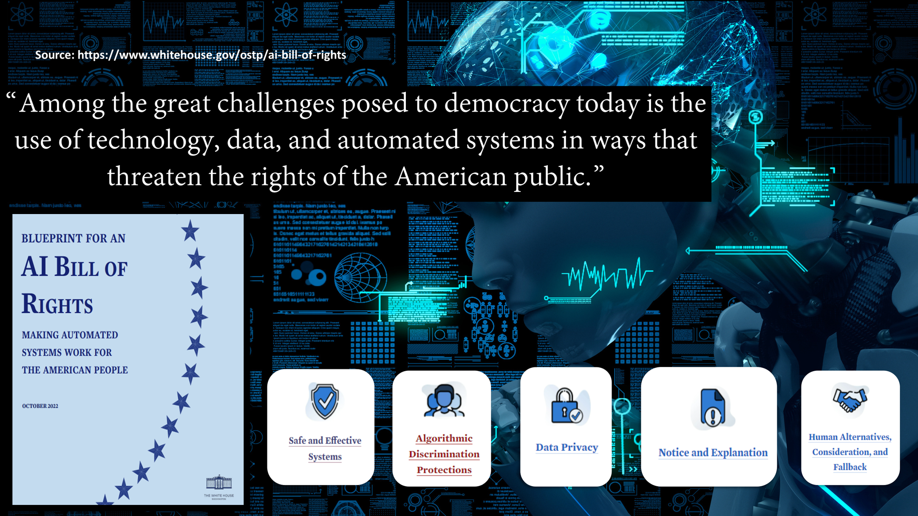

Slide 6

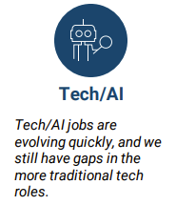
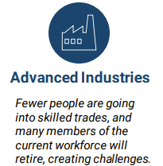
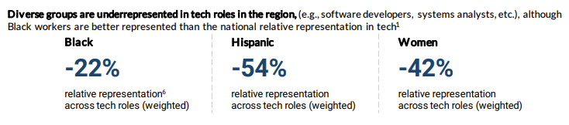
2024 Skill Trends for the Future of Work
SOURCE: Greater Washington Partnership
2024 Skills Forecasting: Employer Signaling for the Future of Work

Slide 7


BUNIFU BELIEVES IN PARTNERSHIPS

Slide 8


Q and A
ASK AWAY!

Slide 9

THANK YOU
MAURICE AND JENNIFER DUNN
EMAIL: INFO@BUNIFUELEARNING.COM
WEBSITE: WWW.BUNIFUELEARNING.COM
MOBILE: 703-655-8488
SaNDAI Cares
JEREMY WILLIAMS, SR.
EMAIL: JEREMY@SANDAICARES.ORG
CLAUDETTE KEEN
EMAIL: CLAUDETTE@SANDAICARES.ORG

